Slide 1
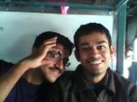
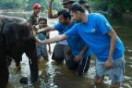
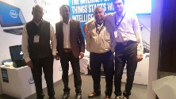
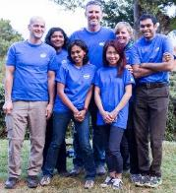
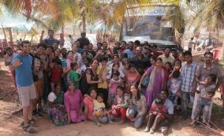
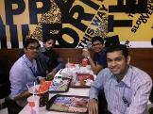
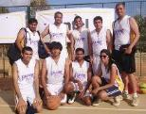
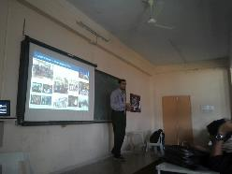
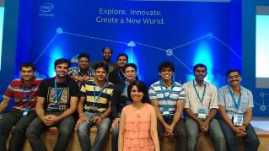

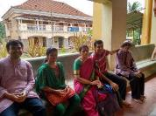
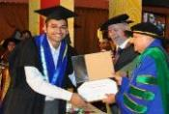
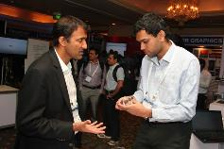
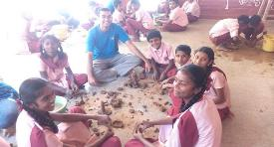
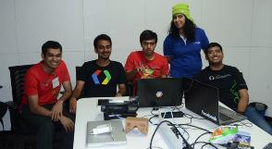
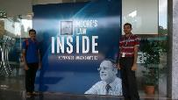
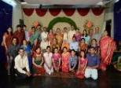
Ganesh Kamath, Software Engineer, Intel
Placement, 2011
Top 50 Volunteers
VLSID Best Booth Exhibit, RealSense Demo, 2016
Technical Expert at IESC Kenya 2015 CCG, People First
Overnight Camping trip, Bubble Center for Autism, 2015
My treat at McDonalds, 2013
Cadence Tournament, Runner-up, 2014
Alumni Speech, Amrita, 2015
Intel IoT Maker Community, IoT Hackathon, April, 2015
Club Secretary, Toastmasters, 2015
My family Goa, 2015
Convocation, 2013
With LaxmiKanth, MentorTogether 2015
Google Hackathon Organizing Team, 2015
IEEE Conference, Edison Demo, 2015
Extended Family
Mud Ganesha Workshop, 2015

